Slide 1
Introduction to Cockroaches
This IPM training program was developed by a partnership including the U.S. Department of Agriculture National Institute of Food and Agriculture, the U.S. Department of Housing and Urban Development, the U.S. Environmental Protection Agency, Centers for Disease Control and Prevention, the Pennsylvania IPM Program, the National Pest Management Association, the National Center for Healthy Housing, and the Regional IPM Centers.
Funding was provide by EPA, HUD, CDC, and USDA-NIFA.
The materials contained herein present a research-based, balanced, and objective approach to pest management in affordable housing and are intended to be used in their entirety. Any nonobjective or partial use of the materials is not recommended. Products, vendors, or commercial services mentioned or pictured in the trainings or presentations are for illustrative purposes only and are not meant to be endorsements.

Slide 2
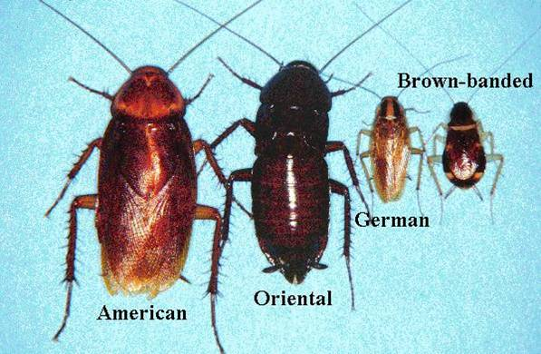
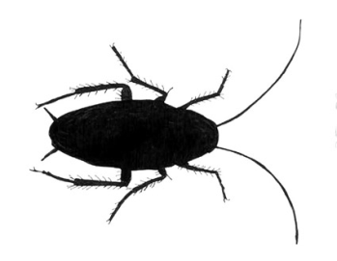


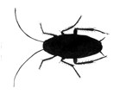
Cockroaches
What we’ll learn:
What is a cockroach
Why they are health hazards
Where they live
How to control them safely
Common cockroaches
cool
hot
high & dry
Most common
sewers & basements
Notes:
2
Here is an outline of this presentation.
Also known as…
roaches
cucarachas, water bugs

Slide 3
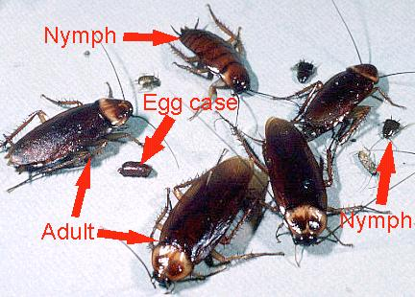
What is a cockroach?
Live where humans provide food and water
Multiple eggs in each egg case means many nymphs (babies)
Active at night -Cockroaches during the day indicate a serious infestation
Nymphs look like small versions of the adults
Notes:
3
Trainees don’t need to be experts on all pests, but they need to know the basic biology and behavior of pests in their buildings.
Nymph is the term used throughout the training. Note that if the pest has wings, it is an adult. If it does not have wings it is either a nymph or a wingless type of cockroach.
Clear up confusion by stating that a “roach” and a “cockroach” refer to the same thing; they are not two different insects.
All cockroaches have two little spikes on their back end called "cerci."
Use this picture to point out the cerci mentioned on the previous slide.

Slide 4
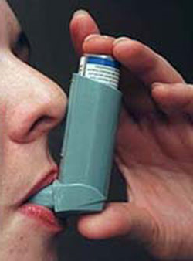
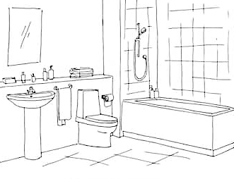
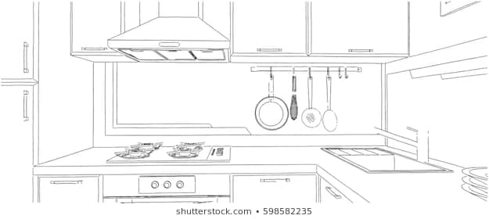
Cockroaches are
Health Hazards
Cockroaches and their frass:
Make asthma worse in sensitive people
Cause asthma in preschool-aged children
Cause or aggravate allergies
Contaminate food, dishes, and counters
Clean dead cockroaches, skins & frass!
Notes:
4
The research on the asthma connections are based on the German cockroaches. For peer-reviewed research about cockroaches, visit www.stoppests.org/Research.
Introduce the word “frass,” which is the poop produced by insects. Cockroaches communicate by smelling and tasting frass.
For sensitive people with asthma, eight units of cockroach allergen per gram of dust can trigger a reaction. ONE female cockroach will produce 1500 units per day! One cockroach and its frass can be an asthma trigger. An IPM program should work to eliminate the cockroaches and clean up the frass. The repairs and measures taken to control one cockroach will benefit the building in more ways than just pest control.
Help the trainees understand that the asthma connection comes from frass and body parts that the cockroaches leave behind. Getting rid of the infestation helps, but does not remove the remains. Cleaning using simple soap (not smelly cleaning agents) will remove the allergens, remove the cockroaches’ mode of communication, and allow residents and staff to see when new evidence shows up.
Have the trainees think about all the areas where cockroach infestations could be health hazards: childcare facilities, recreation rooms, workplaces…
Reference: National Academies Press, 2000. Clearing the Air: Asthma and Indoor Air Exposures. Executive Summary Institute of Medicine. ISBN 0-309-06496-1. See www.nap.edu/books/0309064961/html/.

Slide 5
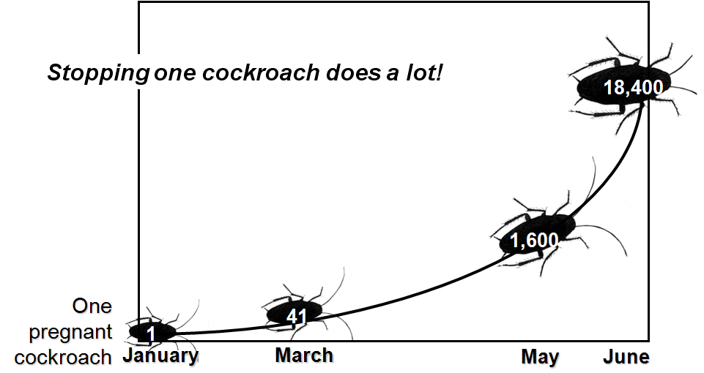
One German cockroach,
1/2 a year…
Notes:
This growth curve is for a German cockroach. A population can get out of hand very quickly. Calculations are based on 40 eggs per case (20 male, 20 female), one month for eggs to develop, one month after hatching they can reproduce. Females develop one egg case a month. The graph assumes no death due to environmental factors and a 1:1 male to female ratio which are unrealistic, but the potential for population growth is a fact, with or without environmental influences.
Use this graph and the asthma connection to make the argument that no number of cockroaches should be tolerated. One can become a lot very quickly. The best way to stop an infestation early is to have sticky trap monitors placed under the sink, behind the refrigerator, and in the bathroom. Monitors can alert you to a new (e.g., from a store or neighbor), or a growing infestation before cockroaches or their frass is seen.
5

Slide 6
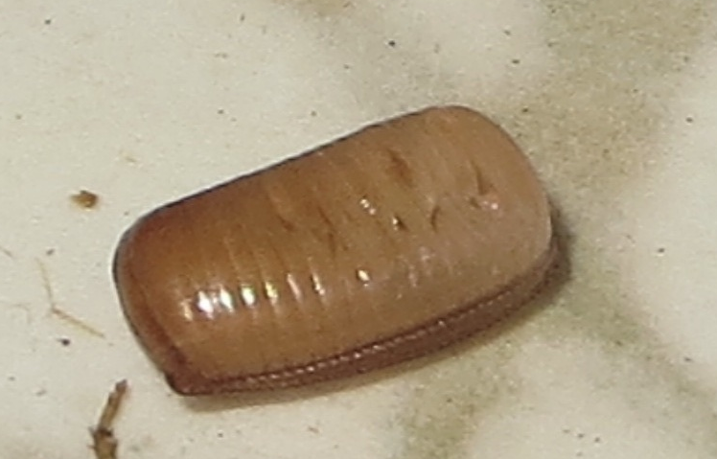
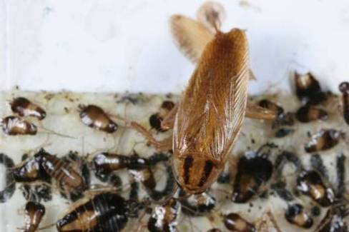
Signs of cockroaches
Live cockroaches
Dead cockroaches and their parts
Frass
Egg cases
11
Notes:
6
IPM doesn’t only deal with the adults that are seen moving around. Cockroaches spend most of their time hiding. Nymphs and pregnant females don't travel much at all. To know about cockroaches, trainees need to know all the evidence of their presence. They may only smell them or see frass. If a live cockroach is seen, it usually means that a good hiding area was disturbed or that the infestation is severe.

Slide 7
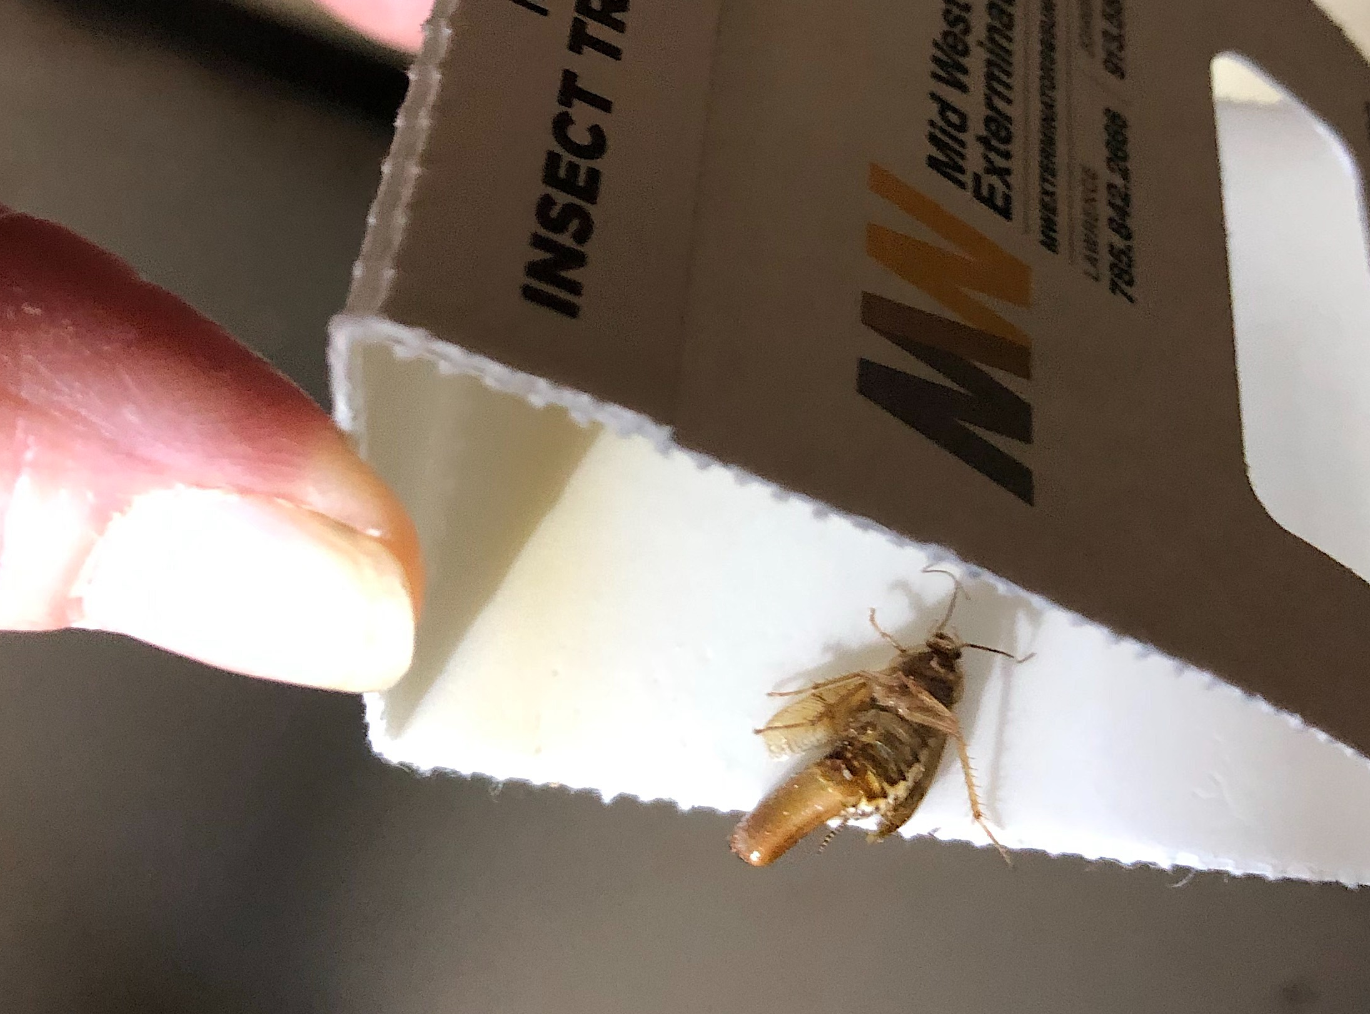
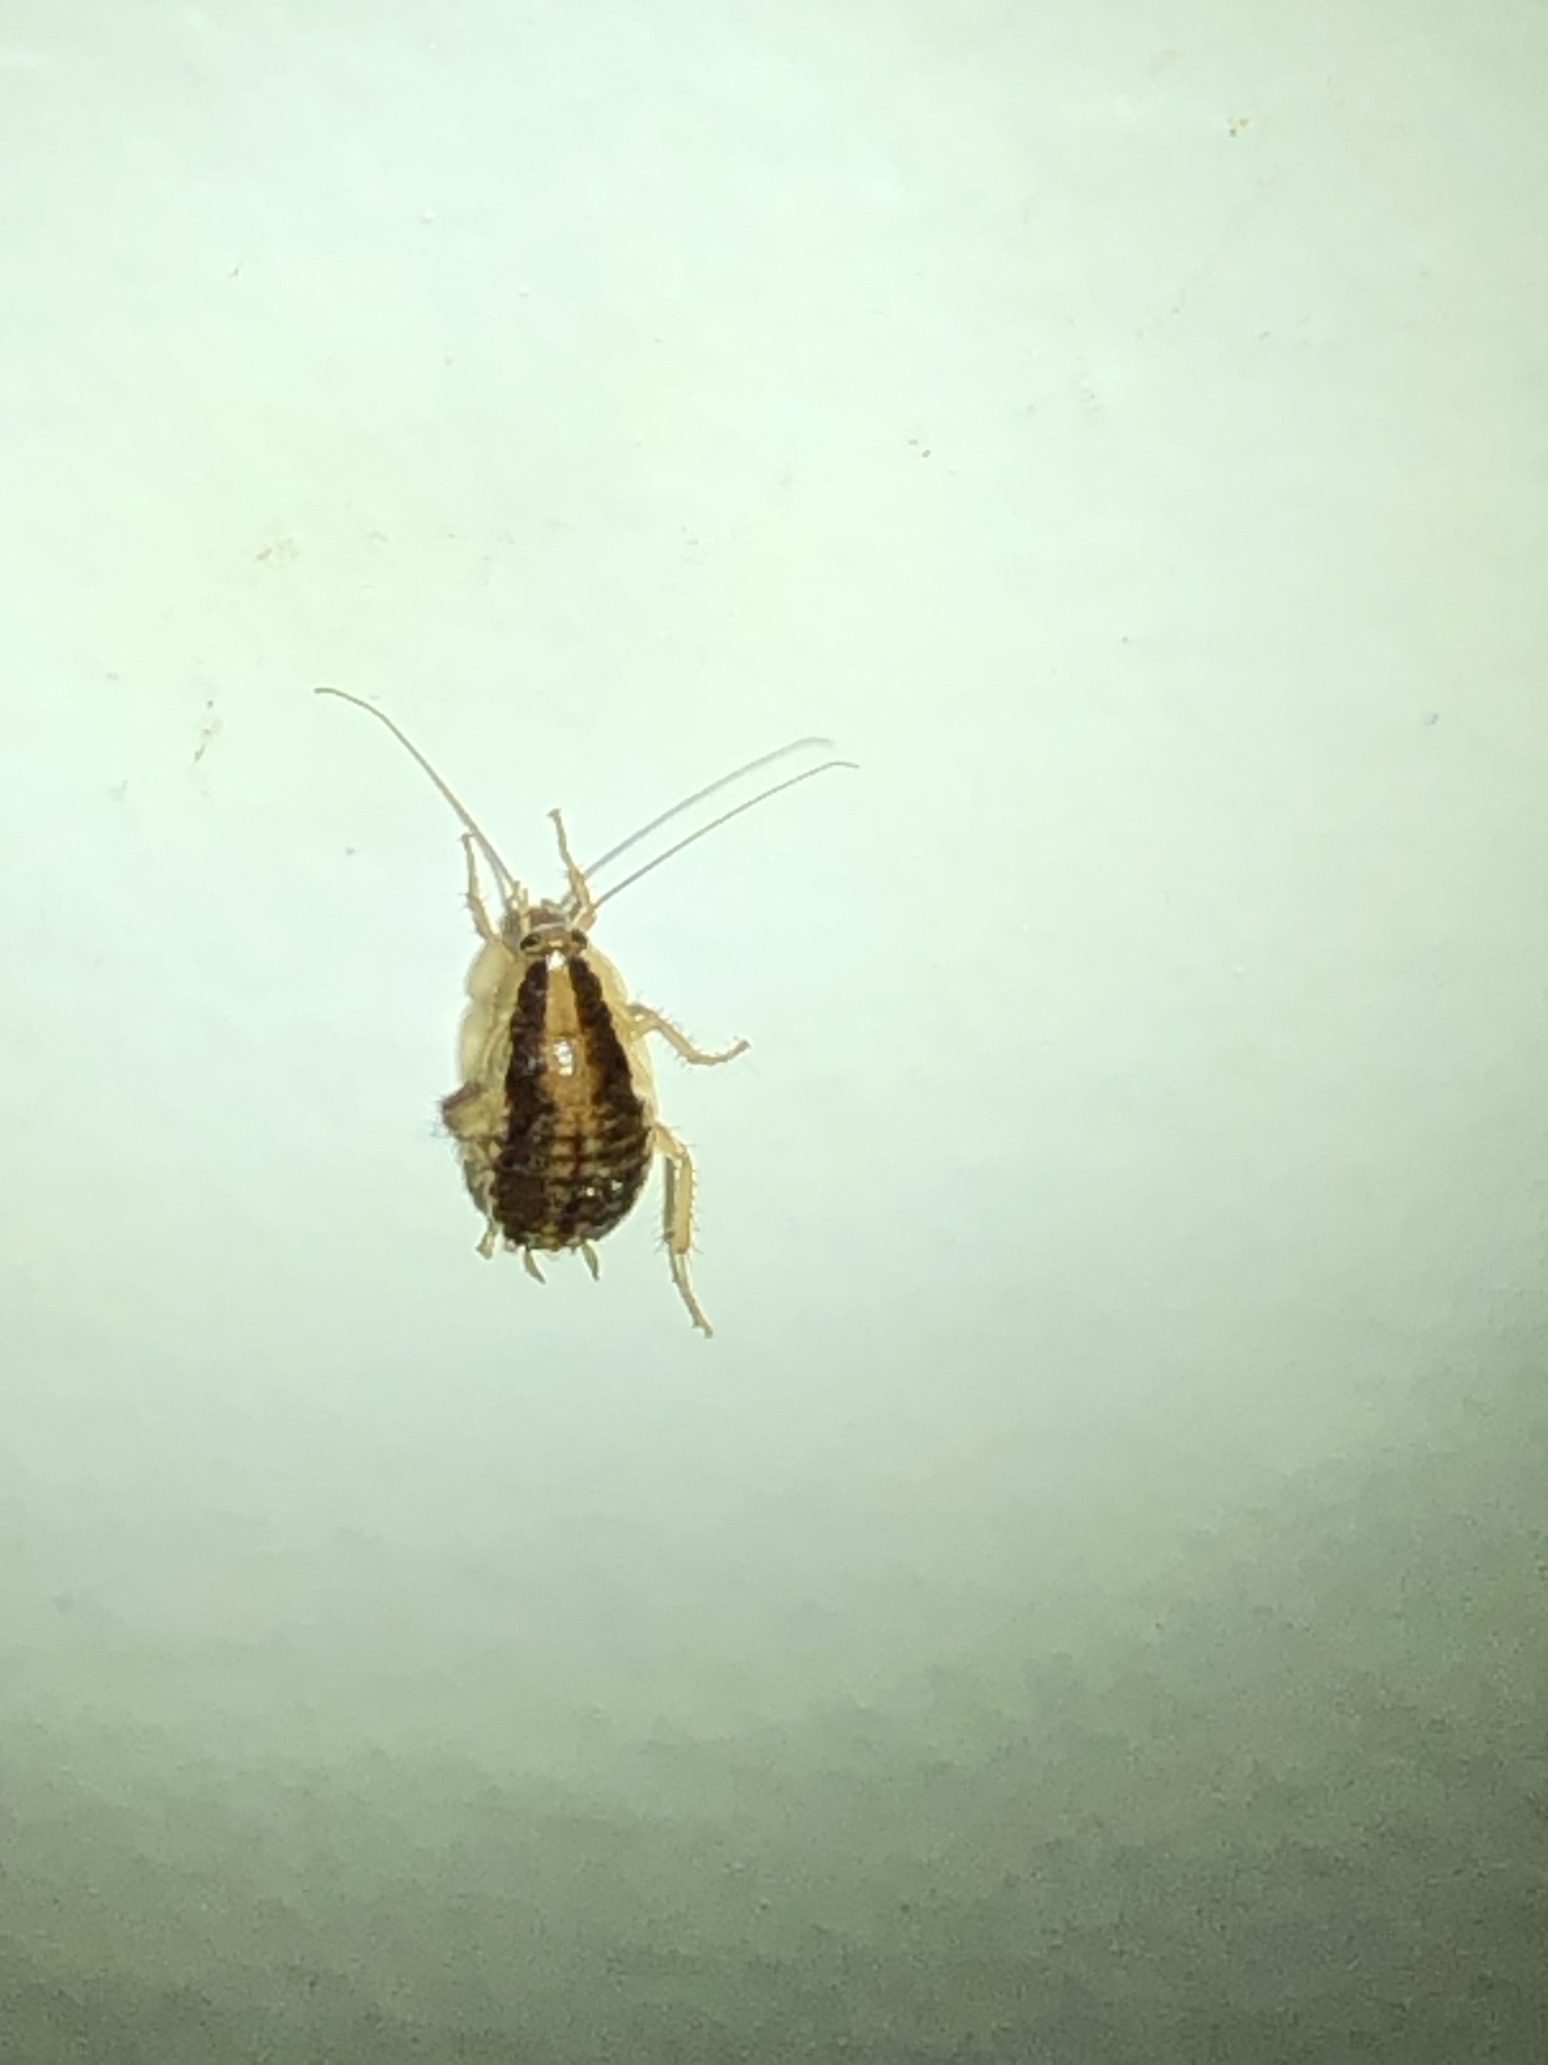
Signs of cockroaches
11
Notes:
7
IPM doesn’t only deal with the adults that are seen moving around. Cockroaches spend most of their time hiding. Nymphs and pregnant females don't travel much at all. To know about cockroaches, trainees need to know all the evidence of their presence. They may only smell them or see frass. If a live cockroach is seen, it usually means that a good hiding area was disturbed or that the infestation is severe.

Slide 8
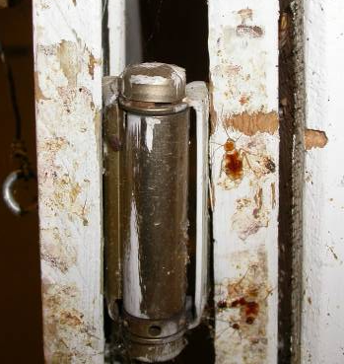
Dead cockroaches
Dead
German cockroaches
on a sticky trap
Brown banded cockroaches
by a door hinge
Notes:
Left: Sticky trap with German cockroach adults and nymphs (mention that the sticky trap is a tool you will show them). The presence of so many nymphs on the trap indicates it may have been placed near a good cockroach hiding spot. It is important to note where traps are placed so that patterns like this can be seen and area can be treated accordingly.
Right: Brown banded cockroaches that have been squished when the door closed.

Slide 9
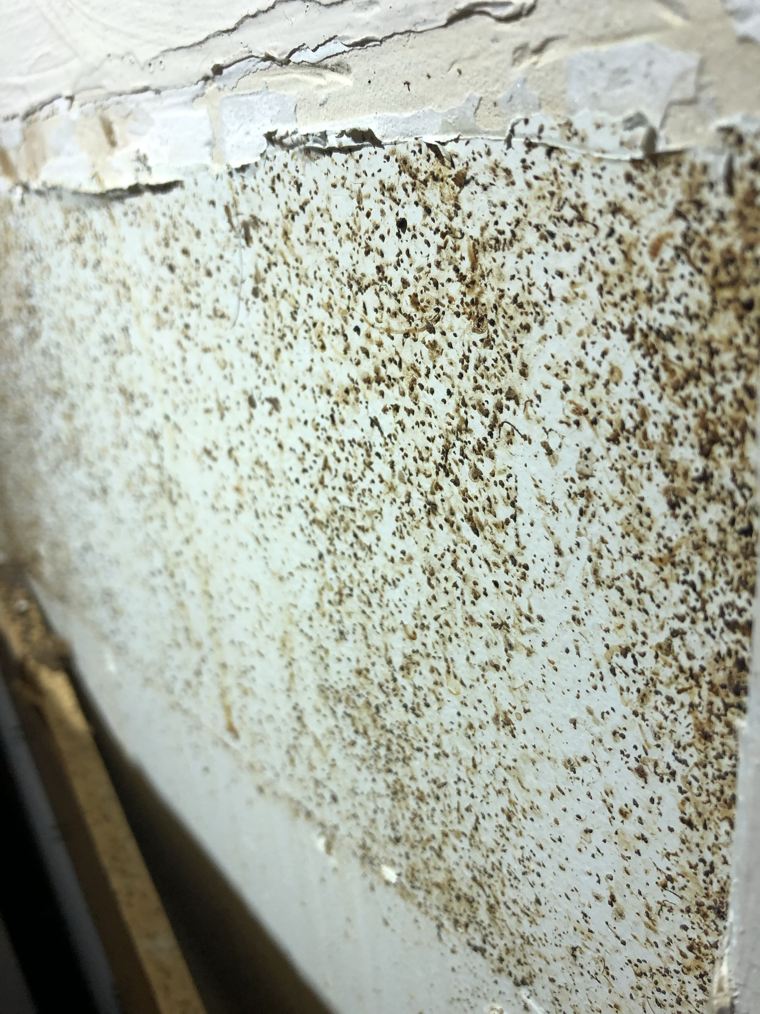
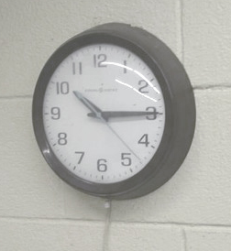
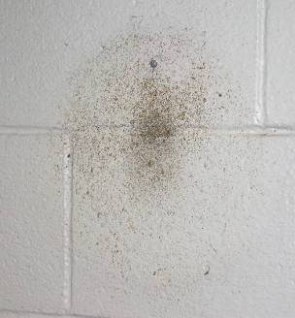
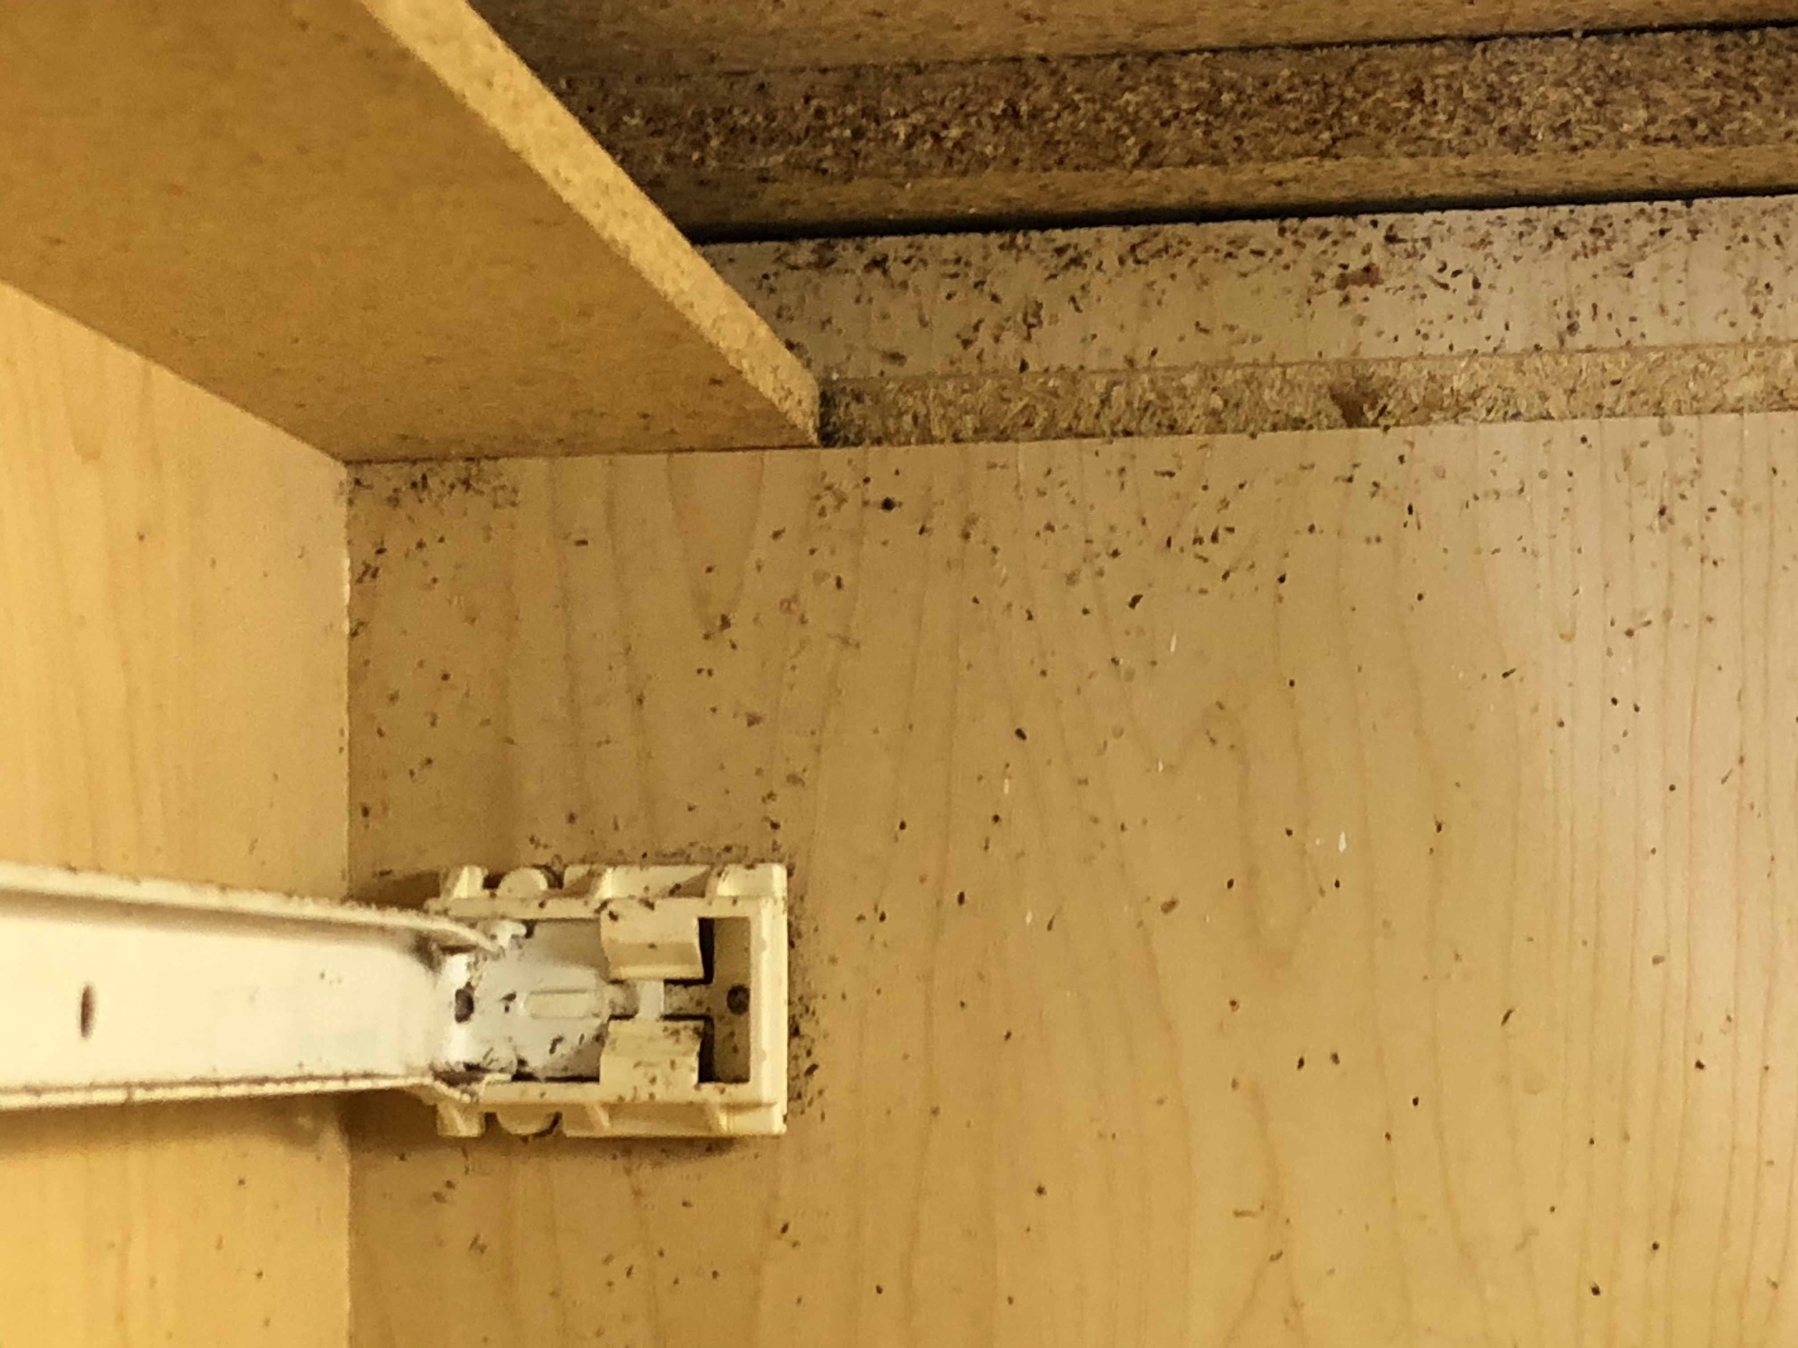
Frass
Wall clock
Behind the wall clock
Notes:
Frass along the top of a door, under a shelf, and on a wall where a clock was hung (note that when the clock was there the place looked clean…trainees have to know where to look to find signs).
Suggestion: use the clock as a review of the kinds of cockroaches. The kind that infested behind the clock were Brown Banded (high and dry).

Slide 10
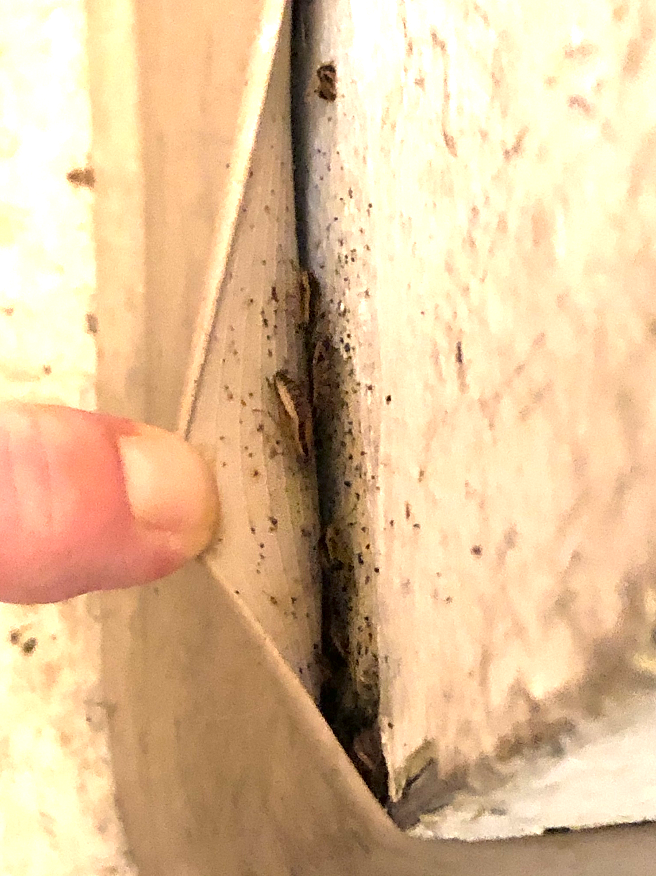
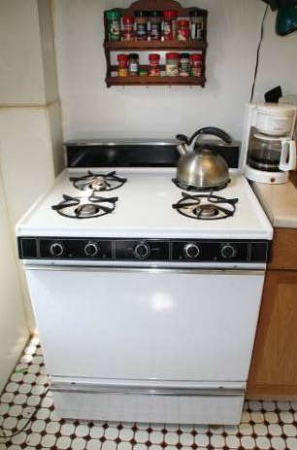
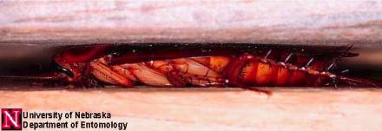
Where cockroaches live
Prefer spots near water but also need food and warmth
In cracks and crevices where their bodies touch surfaces above and below
Anywhere in a building
Residents and staff should report sightings
Notes:
10
Trainees have to know where to look for cockroaches because they are most active at night and most will be hiding at any time. Cockroaches love appliances that have water associated with them.
Suggestion: Have trainees reason that the kitchen is the most likely place (food and warmth from the stove, refrigerator, and under the sink); the bathroom is second because of water. Cockroaches can be found in other rooms as well. Inspection should be done in all rooms (even bedrooms, living rooms), especially when the infestation is bad. If cockroach signs are found in the unit, bait should be placed in all rooms. Take this opportunity to get the trainees to think like a pest and decide where they would want to live.

Slide 11
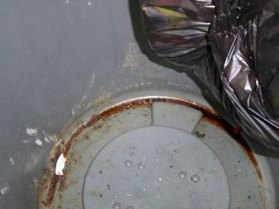
What cockroaches eat
Crumbs
Grease
Trash
Cardboard glue
Just about anything*
  *This helps control with baits
Think about your home. Could you eliminate every crumb?
Under the bag in a trash can
Notes:
11
Have trainees look at photo and offer suggestions for food sources, then click for full list.
Cockroaches will survive on most anything.
* This knowledge will help us later
One drop of grease will feed 20 cockroaches for a day…cleaning is important in cockroach control!
Blaming residents is counterproductive. Controls I possible even in messy homes. It’s impossible to remove every last crumb.

Slide 12
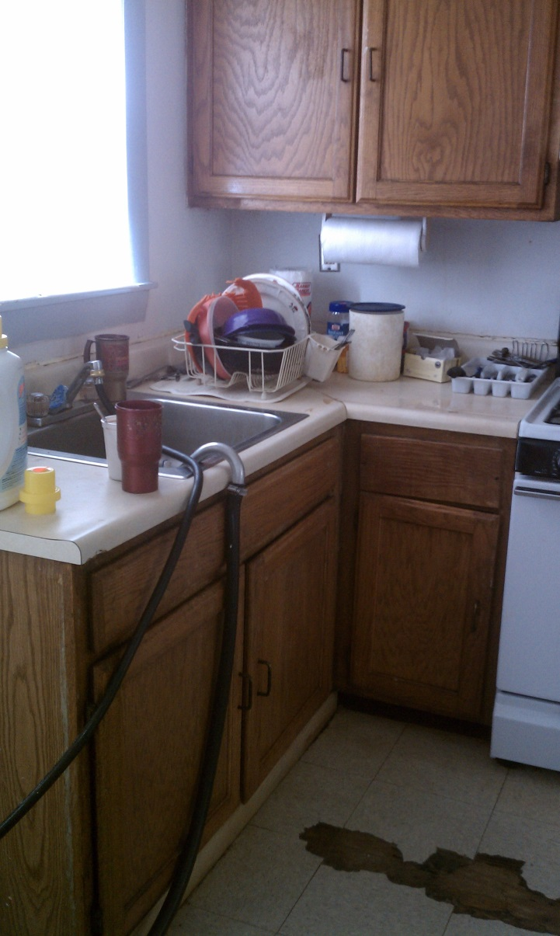
Where cockroaches drink
Sinks
Counters
Floors
Pet bowls
Shower stalls
Sweaty pipes and leaky pipes
Refrigerator drip pans
and gaskets
AC units
Sources of water in a kitchen
Notes:
Cockroaches can live a month without food, but survive only a week without water…removing water sources is important!
Have trainees look at photo and offer suggestions for water sources, then click for full list.
Whose role is it to remove water sources? Depends. If water comes from plumbing or appliance deficiency it’s a maintenance issue.

Slide 13
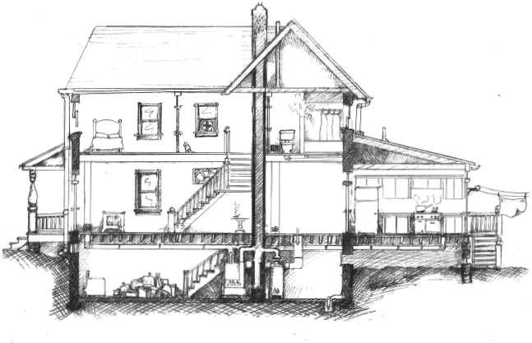
Think like a cockroach
We think of a building as rooms, hallways and stairwells
Notes:
Trainees should go about looking for cockroach signs by thinking like a cockroach.
Most people think of a building in terms of its rooms. Often, the areas of the building that are blocked off here are ignored.

Slide 14
Think like a cockroach
To a cockroach, a building is the spaces between walls and around and in appliances
Notes:
What about your housing stock?
Food and water have been discussed, this slide gets trainees thinking about where cockroaches hide. To know where to look for cockroach hiding spots, trainees must think like a cockroach. Cockroaches live in the building, but they don’t see the building the same way we do. To them, any crack or hole is a door and in-between walls and floors is the safest place to travel and hide: a cockroach freeway.
Maintenance repairs will disrupt cockroach travel and hiding, making them easy to find and kill. The repairs also benefit the building.
In addition to making repairs that prevent future cockroaches, trainees should be taught to clean up after the ones that were present by vacuuming using a HEPA vacuum and scrubbing the frass with soap and water.
Use the training space as an example. Is there a drop ceiling? This is like a pest superhighway. What’s behind the electrical outlet?
Suggestion: Have trainees brainstorm areas where cockroaches might hide.
Macro-thinking: Kitchen, bathroom, boiler room, trash chute, dumpster
Micro-thinking: Toaster, oven, under the stove’s top cover housing the burners, behind/under the refrigerator, in the crevice where the stove joins the counter top, under the sink on the back side of the front center panel and all four corners of the interior of where the sink “sits” in its counter hold frame, behind any loose-fitting escutcheon plate beneath the sink; under the trash can
14

Slide 15
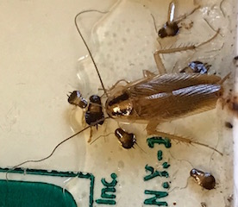
Got cockroaches? Now what?
Everyone has a role
Residents
Staff
Pest Management Professionals
Notes:
15
IPM is tailored to each situation. Practitioners use specific information to make the best decisions about control.
What kind of cockroach? It is useful to know which of the cockroach species is present, because the plan for control should match their life cycles and habits.
How many? Is this just a beginning infestation, with only a few cockroaches, or a full blown, long-term infestation? The former situation can most likely be handled relatively easily, with fewest interventions. The latter will require everyone’s cooperation to the fullest. Investing time to inspect early will help put together an effective and efficient action plan.
Where? Cockroach “hot spots” can be given most attention and may be the source of the whole population. Reference the macro-thinking brainstorm (boiler rooms, trash chutes, or a particularly infested unit). If the most infested units are identified and focused on, the building’s cockroach problem should be controlled. Identifying focus units through inspection should be one of the first steps in an IPM program.
It is also important to record vulnerable or sensitive populations and situations: infants and children, the elderly, pregnant women, and people with chemical sensitivities. Inhabited units will each require a specific plan. Vacant apartments allow more in-depth control to take place, but attempts should still be made to minimize the pesticide residues that might be left behind.

Slide 16
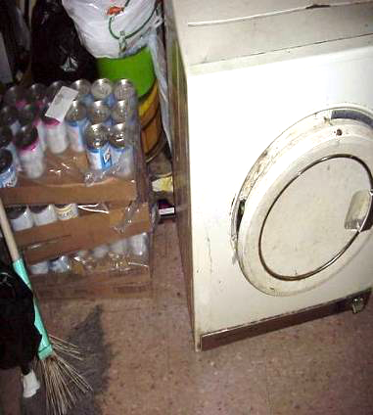
Sanitation first!
Sanitation is eliminating the things that pests need to survive: food, water, and shelter.
Why?
Makes pest control work better
Eliminates hiding spots, food, and water
Notes:
16
"Detailed sanitation" includes all crevices and spaces around and beneath stoves, refrigerators, dishwasher, etc.
By “simple soap” we mean non-smelly cleaning products. It doesn’t take much to break the molecules that trigger asthma, but water alone won’t be effective. Strong chemicals will contaminate nearby baits (discussed later). It’s important to remove the frass, since that is the asthma trigger, but not reduce the efficacy of other control tools.
VACUUM? HEPA 99.97% of particls down to .03 microns
Human hair is 50-150 microns
Reference: www.epa.gov/epp/pubs/products/cleaning.htm for more information on appropriate cleaning products.

Slide 17
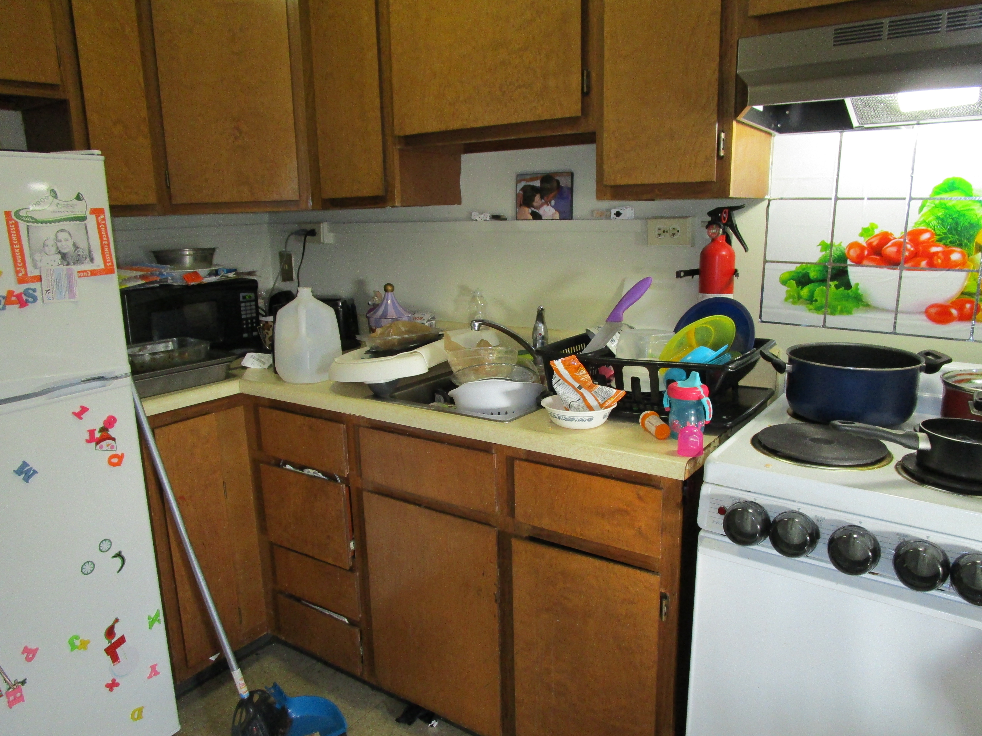
Residents
clean up food and dishes (limit food source)
don’t use sprays or bug bombs
observe and REPORT
*what if resident can’t…or won’t?
Notes:
17
IPM is tailored to each situation. Practitioners use specific information to make the best decisions about control.
What kind of cockroach? It is useful to know which of the cockroach species is present, because the plan for control should match their life cycles and habits.
How many? Is this just a beginning infestation, with only a few cockroaches, or a full blown, long-term infestation? The former situation can most likely be handled relatively easily, with fewest interventions. The latter will require everyone’s cooperation to the fullest. Investing time to inspect early will help put together an effective and efficient action plan.
Where? Cockroach “hot spots” can be given most attention and may be the source of the whole population. Reference the macro-thinking brainstorm (boiler rooms, trash chutes, or a particularly infested unit). If the most infested units are identified and focused on, the building’s cockroach problem should be controlled. Identifying focus units through inspection should be one of the first steps in an IPM program.
It is also important to record vulnerable or sensitive populations and situations: infants and children, the elderly, pregnant women, and people with chemical sensitivities. Inhabited units will each require a specific plan. Vacant apartments allow more in-depth control to take place, but attempts should still be made to minimize the pesticide residues that might be left behind.

Slide 18
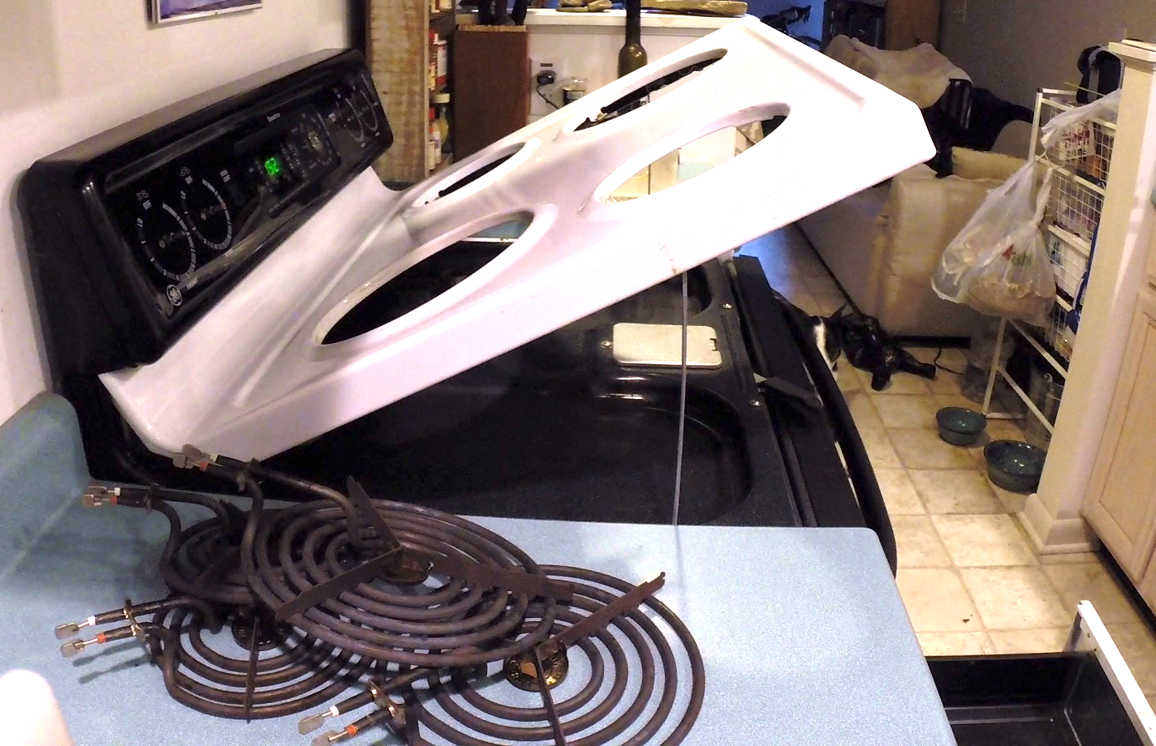
Sanitation
Notes:
Thorough Stove cleaning:
provide cleaning classes,
orientation to stoves,
IPM intervention for families with asthma?
Ask attendees to raise their hand if they have taught this skill to a resident, family member, or friend.

Slide 19
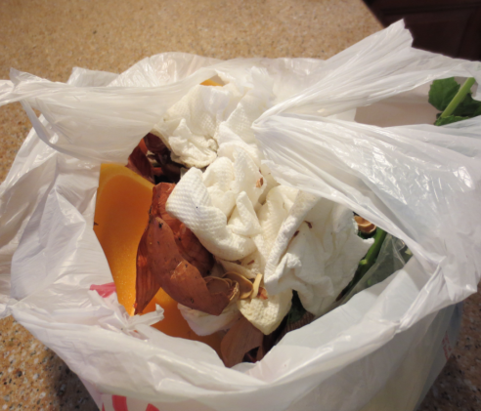
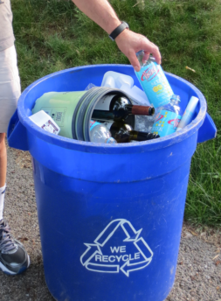
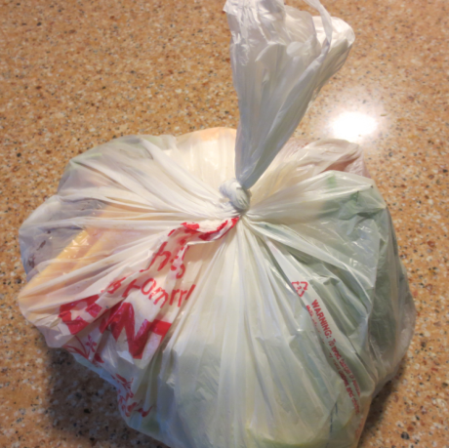
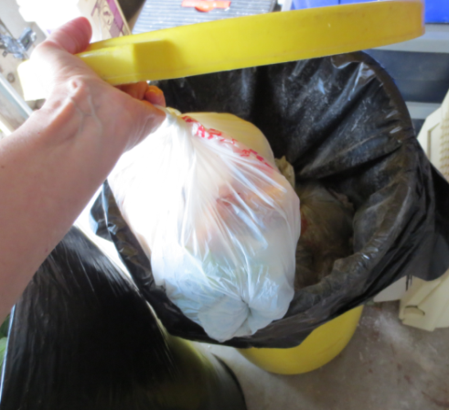
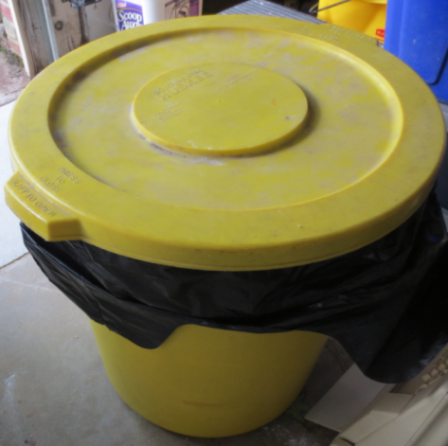
Recycling & Trash
Don’t keep cardboard or paper bags
Rinse & recycle food & drink containers
Garbage – empty daily
Trash in covered container (tight lid)
Wash inside the trash can
Image credits: Jayne Windham
Notes:
Cardboard & paper bags are harborage for pests.
Pests (especially roaches) can live in cardboard boxes.
Rinse recyclables, take out ASAP
Put “food-based” garbage (meal prep, meat trays, plate scrapings) in separate bag – Good re-use of plastic food bags.
Tie tightly and remove to covered trash bin nightly.
Tight trash lids keep pests out of trash containers.
Smooth sides keep pests from climbing in.
Or use facility dumpsters if available.
Washing inside the can is important. Sometimes things fall between the liner & the can, we miss the can, or the bag tears and we have a stick mess underneath.

Slide 20
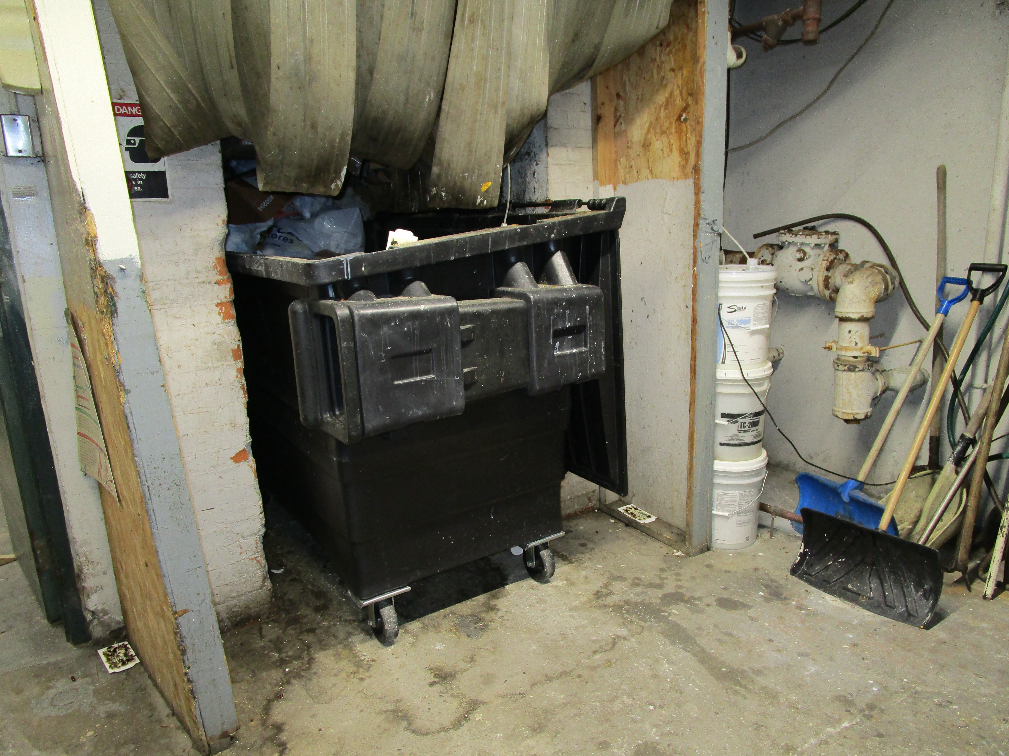
Staff
Management - monitor resident compliance, Intervene when treatment fails, notice patterns, oversee contractor
Janitors – clean and report in common areas
Maintenance – clean and report in common areas, exclusion, fix leaks, clogged pipes and door sweeps
Procurement – good contract!
Boiler room
Notes:
20
IPM is tailored to each situation. Practitioners use specific information to make the best decisions about control.
What kind of cockroach? It is useful to know which of the cockroach species is present, because the plan for control should match their life cycles and habits.
How many? Is this just a beginning infestation, with only a few cockroaches, or a full blown, long-term infestation? The former situation can most likely be handled relatively easily, with fewest interventions. The latter will require everyone’s cooperation to the fullest. Investing time to inspect early will help put together an effective and efficient action plan.
Where? Cockroach “hot spots” can be given most attention and may be the source of the whole population. Reference the macro-thinking brainstorm (boiler rooms, trash chutes, or a particularly infested unit). If the most infested units are identified and focused on, the building’s cockroach problem should be controlled. Identifying focus units through inspection should be one of the first steps in an IPM program.
It is also important to record vulnerable or sensitive populations and situations: infants and children, the elderly, pregnant women, and people with chemical sensitivities. Inhabited units will each require a specific plan. Vacant apartments allow more in-depth control to take place, but attempts should still be made to minimize the pesticide residues that might be left behind.

Slide 21
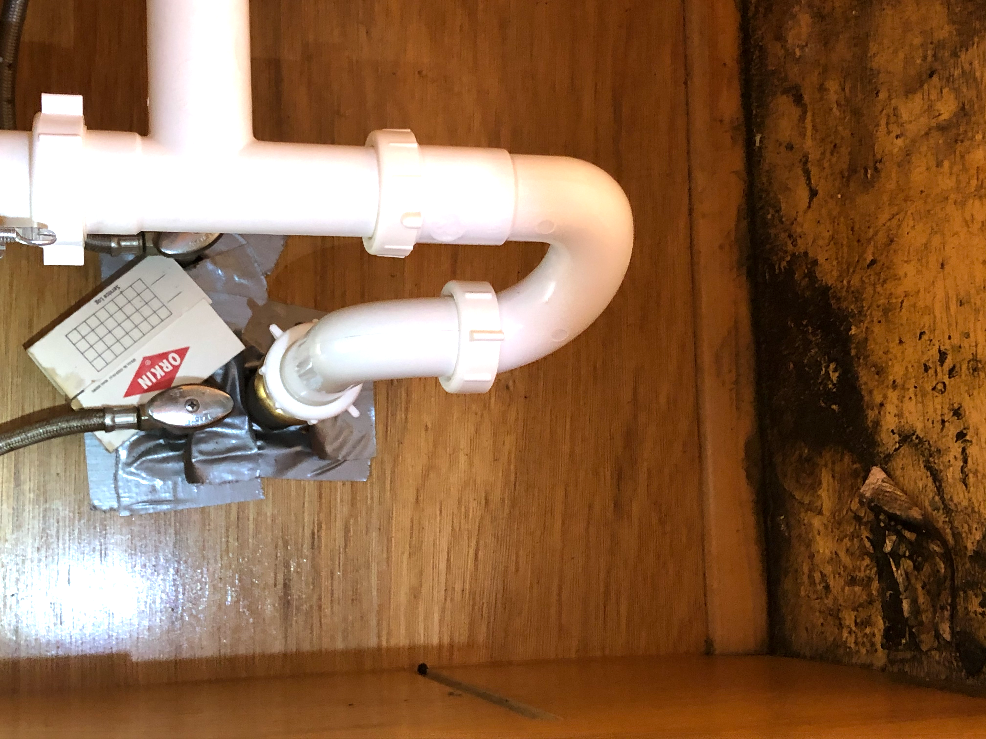
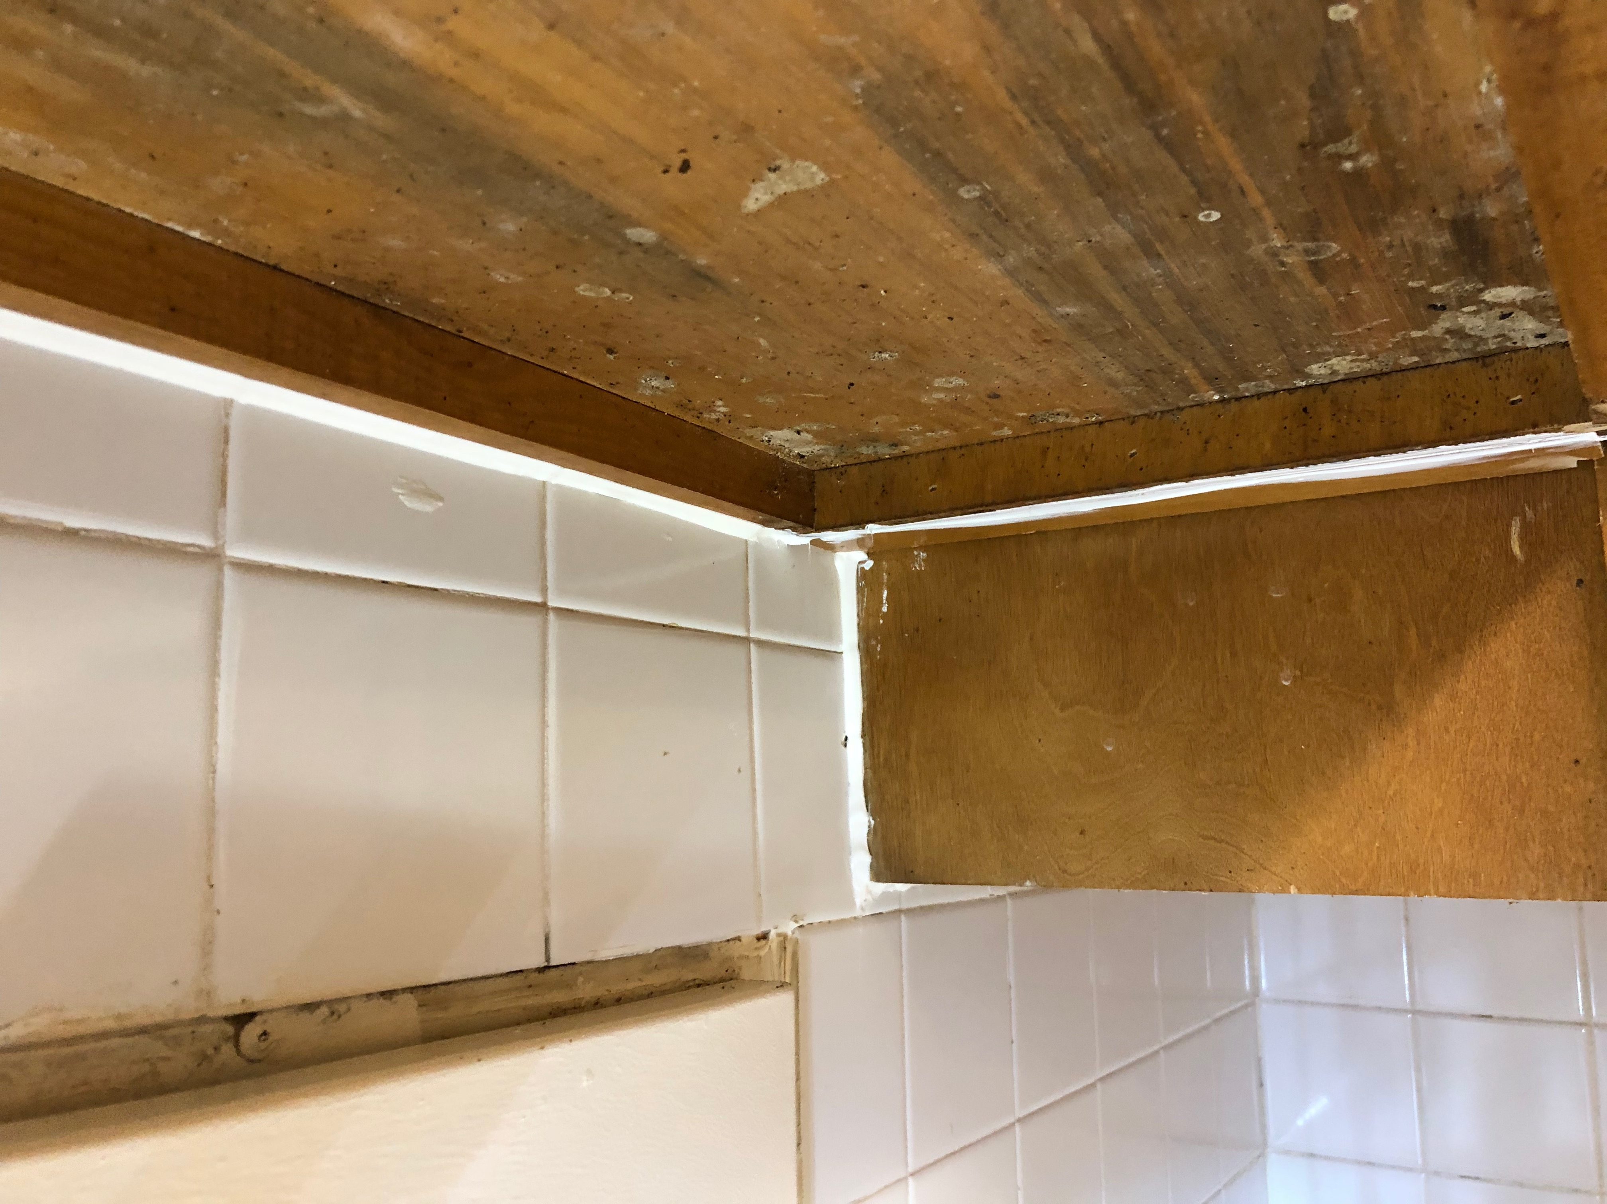
Exclusion
Maintenance - Seal cracks and holes
Use:
silicone caulk
screens
door sweeps—
always on boiler rooms, trash rooms, exterior doors
Notes:
21
The pictures show caulk applied at unit turnover to limit hiding spots behind cabinets and top picture shows a resident’s attempts to seal off the space under the sink where cockroaches were entering their home. Making these types of repairs is good for the building and good for pest control.. Show and tell the exclusion tools listed, then encourage a discussion about caulk. Although most expensive, silicone caulk will provide the longest lasting control since it adheres to surfaces and holds through the inevitable slight shifting of buildings.
Weatherstripping is not pest-proofing. Door sweeps are essential on doors leading to the outside.
Young cockroaches want a crevice as thin as a dime. Adult males want a space the thickness of a quarter. Pregnant females want the most space of all to hide: two stacked nickels. All like to be squeezed.
Reference: How to Control Pests Safely pp. 6-7
Reference: Bobby Corrigan’s Sealant vs. Caulk Comparison

Slide 22
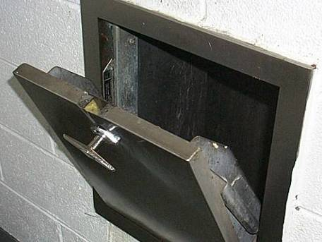

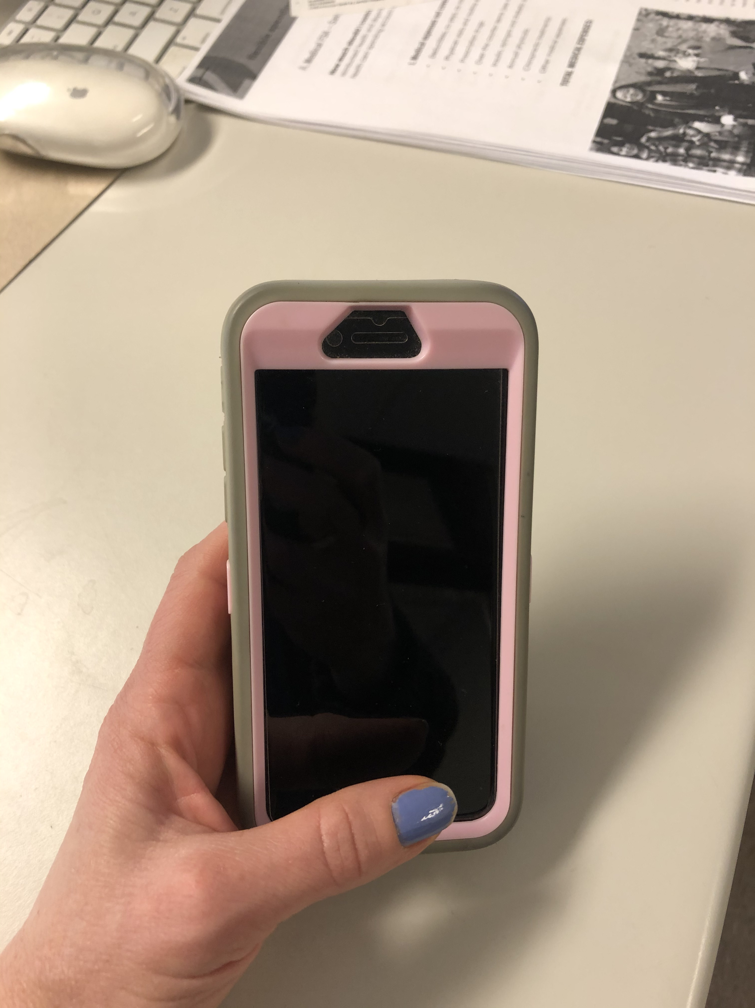
Inspection
Use a flashlight
Look for evidence
Look for conditions: food, water, and good hiding spots
Take pictures
Trash chute
Notes:
See something say something!
To inspect effectively, trainees must know to look in areas where cockroaches are living. They should look where cockroaches might hide for the previously discussed signs of cockroaches. A reporting system is crucial so the PMP will know where to apply pesticides (and where NOT to apply), the staff will be aware of units having sanitation issues, and all will know if any units are occupied by vulnerable or sensitive populations. If cockroaches are being reported in clean units, trainees should know to check the adjacent units because they may be generating a cockroach population.
Children are often the best inspectors. If there are kids in an area, they should be asked if they have seen the target pest. They may know the source.
22

Slide 23
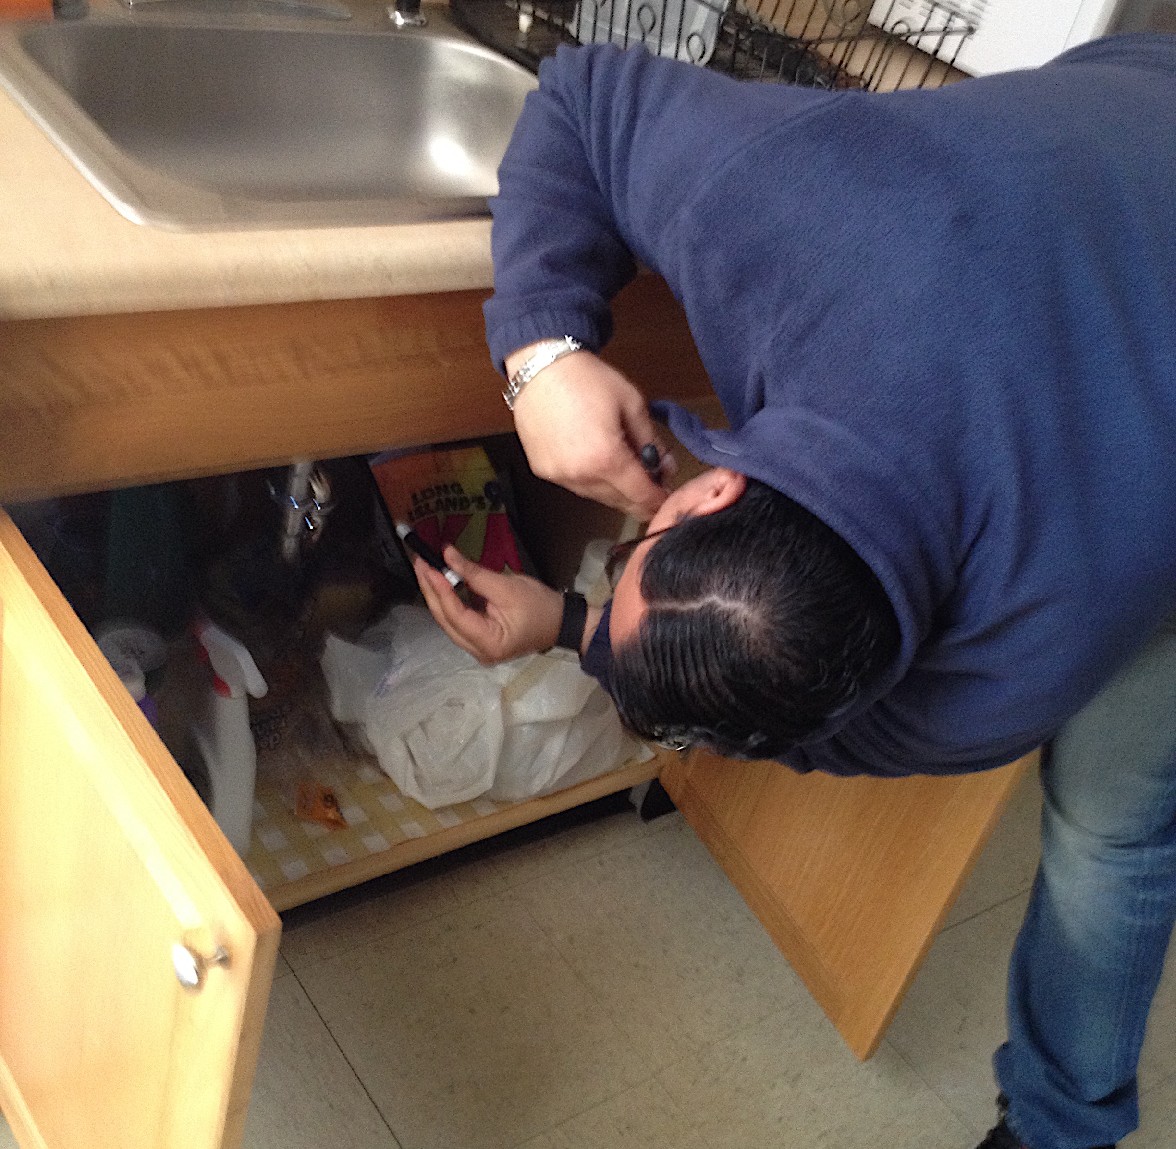
Pest Management Professionals
Use solutions that provide:
  Most effective prevention and control
    Least risk to residents and staff
    Monitor
    Follow-up in 1-4 weeks with inspection and treatment
Your PMP should conduct a thorough inspection
Notes:
23
IPM is tailored to each situation. Practitioners use specific information to make the best decisions about control.
What kind of cockroach? It is useful to know which of the cockroach species is present, because the plan for control should match their life cycles and habits.
How many? Is this just a beginning infestation, with only a few cockroaches, or a full blown, long-term infestation? The former situation can most likely be handled relatively easily, with fewest interventions. The latter will require everyone’s cooperation to the fullest. Investing time to inspect early will help put together an effective and efficient action plan.
Where? Cockroach “hot spots” can be given most attention and may be the source of the whole population. Reference the macro-thinking brainstorm (boiler rooms, trash chutes, or a particularly infested unit). If the most infested units are identified and focused on, the building’s cockroach problem should be controlled. Identifying focus units through inspection should be one of the first steps in an IPM program.
It is also important to record vulnerable or sensitive populations and situations: infants and children, the elderly, pregnant women, and people with chemical sensitivities. Inhabited units will each require a specific plan. Vacant apartments allow more in-depth control to take place, but attempts should still be made to minimize the pesticide residues that might be left behind.

Slide 24
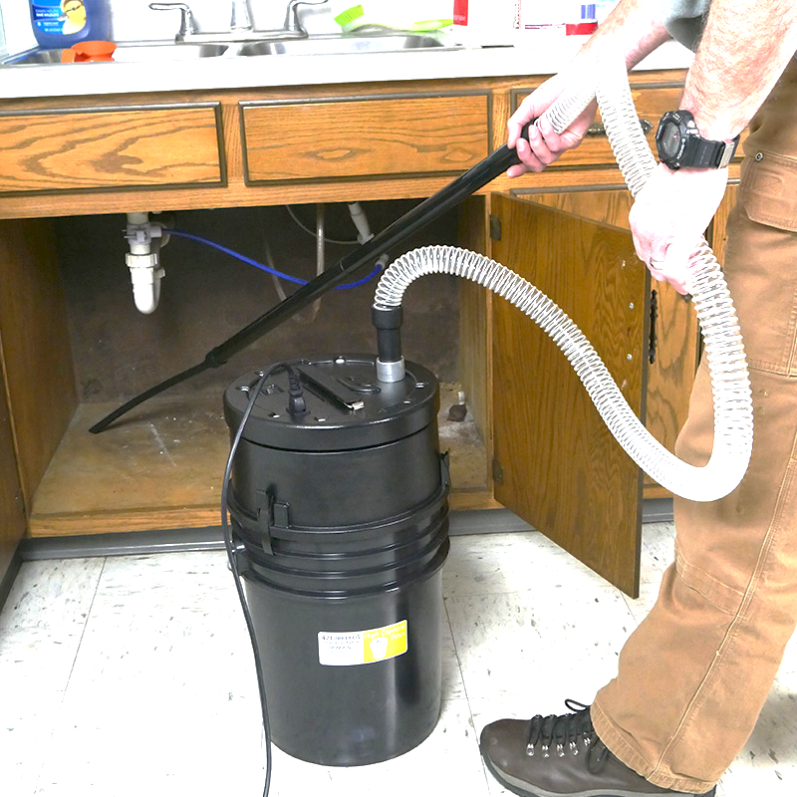
Vacuum
Remove live and dead cockroaches
Reduce asthma and allergen triggers
If evidence is removed with vacuuming, and no new evidence appears, you can confirm elimination
The Atrix High Capacity HEPA (High Efficiency Particulate Air) vacuum system
Photo: Atrix.com

Slide 25
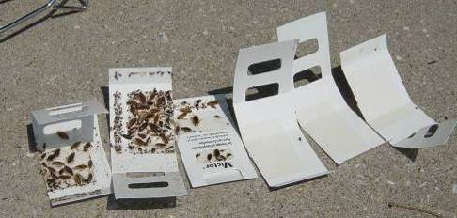

Monitors
Sticky traps monitor activity 24/7
Place where they travel- at corners and near warmth, food, and water
Help with reporting
Do not disturb or throw out monitors (residents)
Tell us a lot! - Where, how many, elimination confirmation
Notes:
Cockroaches are active at night when people aren’t looking and they hide where people don’t usually look. Monitors help find cockroaches when and where people can’t.
Show a sticky trap.
A common way to monitor for cockroaches is to use sticky traps. Sticky mineral-based glue is put on paper. There is no pesticide.
The paper is folded to keep out other pests out (and the curious cat). In this type, the paper is folded into a triangle. It has glue in small places on the outside to keep it in place. The key is to properly place the trap in a corner or near a water source.
A few things to note about the pictures:
The traps with cockroaches were in the kitchen and bathroom. The kitchen was worse. The other traps were in the bedroom.
The small cockroaches (nymphs) in the lower left photo indicate that the trap was close to where cockroaches were thriving. Adult male German cockroaches travel about 12 feet to find what they need to survive, adult females go about 6 feet, nymphs usually stay within a foot of the place where they find food, water, and shelter.
The tongs in the background allow one to avoid touching the cockroaches on the traps.
The cockroaches can survive for several weeks on the glue trap.
Sticky traps are information-gathering tools. They alert to a growing infestation in common areas, such as trash chutes and trash storage areas. To see changes that indicate a growing population, the sticky traps must be checked and changed periodically. Suggest writing a date and specific location (e.g. Unit 315 Bathroom) on them when placing so that patterns and the time it took to catch the number of cockroaches will be known. The concept of an IPM log will be introduced in the IPM and Pesticide Use section, but take this opportunity to demonstrate how keeping records of trap counts could tell a lot about the problem.
Traps that are covered, like the three on the left, above, should be put in a re-sealable bag and brought to the property manager or designated person who will assess the information.
Hand out sticky traps and have trainees put them together. Ask trainees to brainstorm areas where sticky traps should be placed. Note that this will be practiced later.

Slide 26
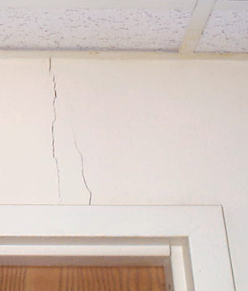
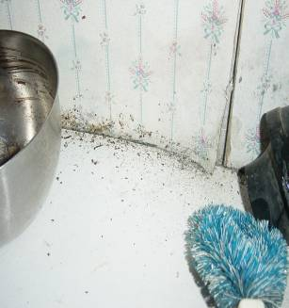
Exclusion
Maintenance - Seal or fix cracks, or holes that cockroaches could get through.
Use:
silicone caulk
copper mesh
screens
door sweeps—
always on boiler rooms and exterior doors
Notes:
26
The left picture shows a wallpapered wall in a bathroom that needs repair work. It’s harboring cockroaches. Making these types of repairs is good for the building and good for pest control. The photo on the right is a crack in the plaster that could be hiding cockroaches. Show and tell the exclusion tools listed, then encourage a discussion about caulk. Although most expensive, silicone caulk will provide the longest lasting control since it adheres to surfaces and holds through the inevitable slight shifting of buildings.
Weatherstripping is not pest-proofing. Door sweeps are essential on doors leading to the outside.
Young cockroaches want a crevice as thin as a dime. Adult males want a space the thickness of a quarter. Pregnant females want the most space of all to hide: two stacked nickels. All like to be squeezed.
Reference: How to Control Pests Safely pp. 6-7
Reference: Bobby Corrigan’s Sealant vs. Caulk Comparison

Slide 27
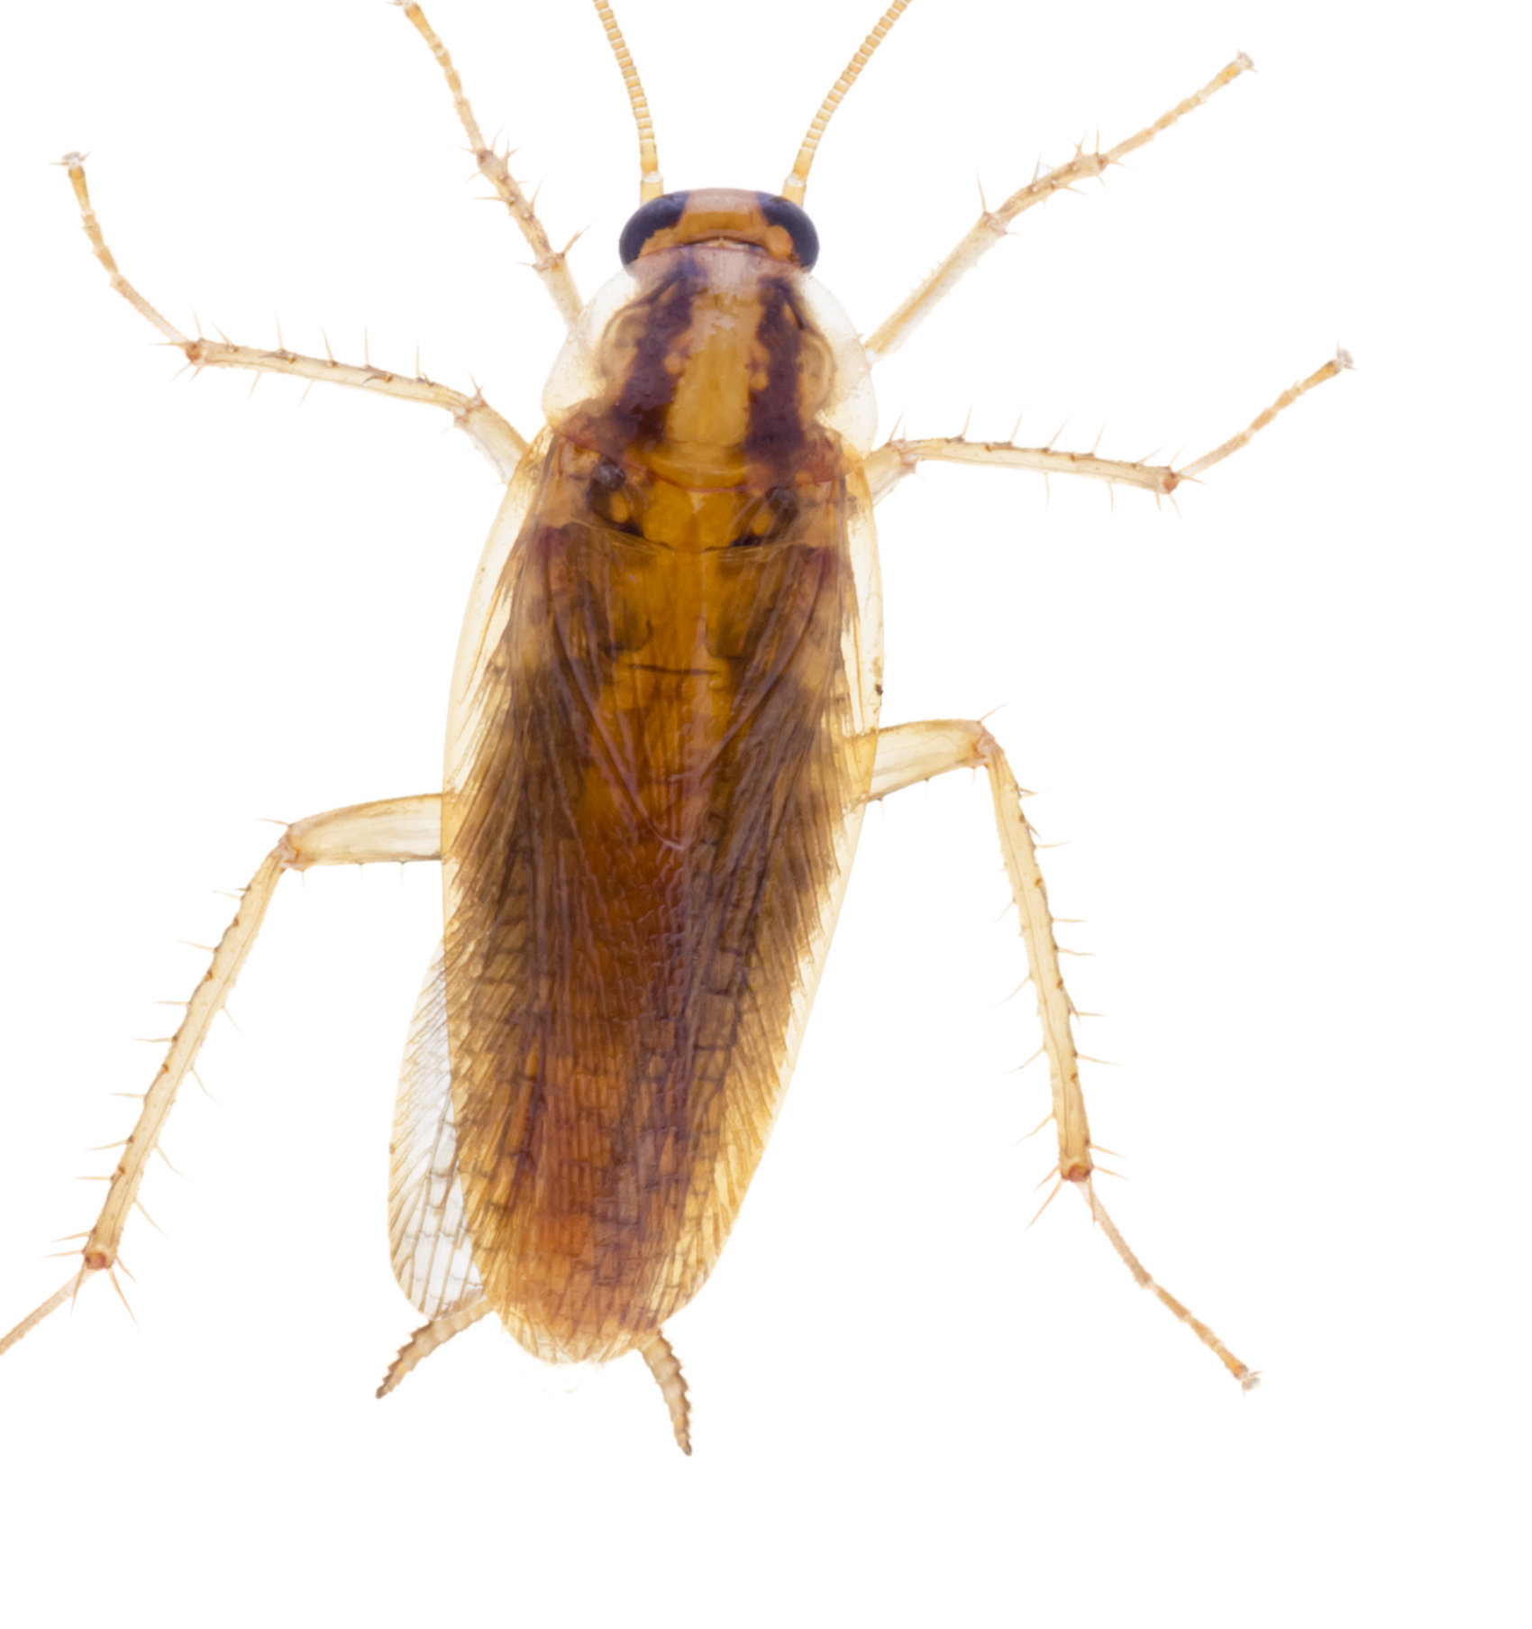

Treatment
The pest management professional:
Vacuum
Monitoring and inspection
Only licensed individuals should apply pesticides
Residents should not apply pesticides
OR
Notes:
27
After this slide will be three pesticide options for cockroaches that can be used to complement other IPM practices.
Pesticides may not be an option if an individual has chemical sensitivities; in that case sanitation, sticky traps, and exclusion will need to be the IPM plan.

Slide 28
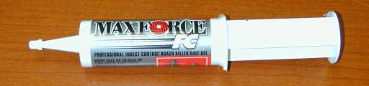
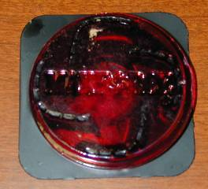
Baits
The most effective pesticide option
Cockroaches feed on the bait, take it back to hiding cockroaches and share
Use in every room where inspection and monitors find evidence
Gel Bait
Bait Station
Notes:
28
Baits are the most common and effective pesticide for cockroaches nationwide.
Baits and gels rely on roaches wanting to eat them. If baits are contaminated with chemicals that the cockroaches recognize as poison, cockroaches will avoid them. This is often why residents say that baits “don’t work.” They won’t if the resident is also applying aerosol cockroach killers in the same room. Strong-smelling cleaners can have the same effect. Nicotine from smoking will also contaminate the bait. This is one reason why gloves should be worn when placing bait. When cleaning out cabinets before putting in bait stations, strong-smelling cleaners should not be used. Regular soap and water is effective and won’t ruin the bait’s effectiveness.
The photos above are of two common methods of delivering baits. The photo on the right shows a bait station. The photo on the left shows the same pesticide in gel form. Small dots (about the size of a pea) of this gel are put into cracks, crevices, and corners where there is frass. It works the same as the bait station but more care must be used to keep it away from curious children. It should be used only in cracks and crevices to keep children from getting at it. When re-applying, old bait should be removed. It lasts about three months—less time than bait stations since it is more exposed to the air. When it dries out, the cockroaches will not be attracted to it.
Note that bait storage is also a concern. If baits are stored with herbicides or cleaning products, they may become contaminated and ineffective. This holds true for rodent baits (which will be discussed later).
Suggestion: Pass out bait station.
Reference: See www.epa.gov/epp/pubs/products/cleaning.htm for more information on appropriate cleaning products.

Slide 29
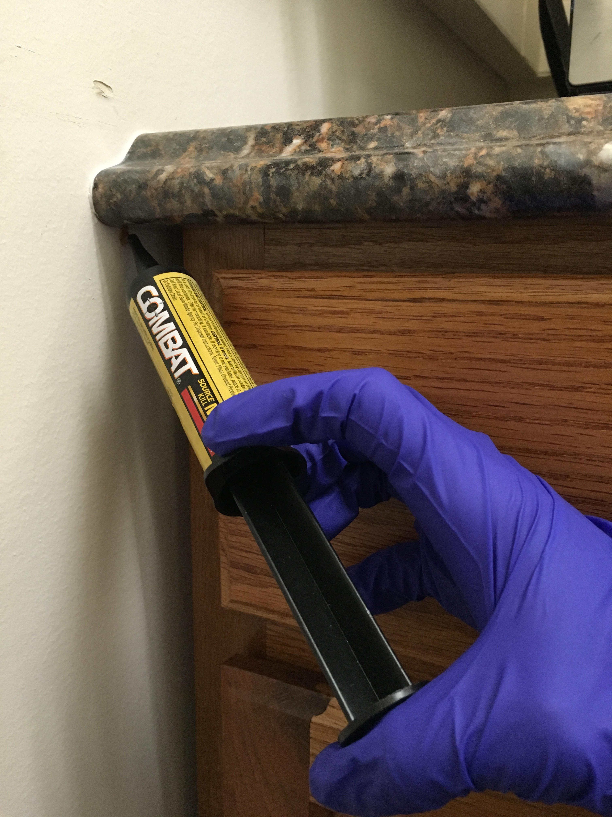
Baits
Work best when:
  Bait is the only food
  Not contaminated with sprays and scented cleaners
Will still work where sanitation is low
Notes:
29
Cockroaches eat the pesticide, and go back to where they like to hide. They die slowly. Other cockroaches feed on the dying cockroach's frass and body and they get poisoned too. Some people don’t trust them because they do not see dead cockroaches. Reassure residents that baits take a little longer to kill cockroaches than conventional sprays or aerosols, but are effective. Sometimes the baits consist of insect growth regulators (IGRs). These products interfere with the cockroach’s ability to grow and reproduce. IGRs are slow acting but very effective.
The see-through cover allows the user to see the pesticide in the bait station and tell if the cockroaches have been feeding. The pesticide is the white or brown material in the center. If the bait isn’t being eaten, trainees should first check for other food sources in the area (sanitation first!). If the cockroaches have not fed on the bait after a few days, they should place it in a different area. If that doesn’t work, try a different kind of bait. Bait stations are popular because there is very little risk of pesticide exposure and the container is tamper-resistant. It lasts about three to six months depending on conditions (including how many cockroaches are eating the bait).
Sometimes cockroaches learn to avoid a type of bait. If cockroaches stop feeding on the bait, try a new type of bait. It is not a bad idea to rotate baits (choose a bait with a different active ingredient) every 6 months or year.
_____
Reference: How to Control Pests Safely, pp. 10-11.
Reference: Cincy Cockroach Study

Slide 30
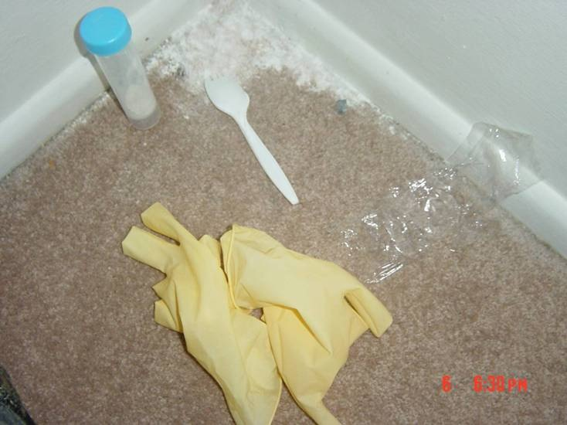
Dusts
Professionally applied
Boric acid, diatomaceous earth, silica gel
Light dusting
Dusts last as long as they stay dry
In walls, under and behind cabinets at turnover or when making major
repairs
Notes:
30
Insecticidal dusts will kill insects in one of three ways, depending on the active ingredient. Dusts that contain boric acid act as stomach poisons. The cockroach walks through the dust and ingests the poison when cleaning itself. Other dusts like boric acid contain silica, which is like tiny shards of glass. It affects the cockroach's outer layer so that they can't retain enough water to stay alive. Many PMPs use dusts with active ingredients in addition to the silica for faster kill.
Insecticidal dusts can be put in the wall void before replacing the faceplates of electrical outlets. If using metal-tipped bulbs, care should be taken around electrical sockets.
Suggestion: Avoid bias. Give trainees the facts about each product and let them discuss and draw conclusions for themselv
If the dust can be seen, there’s too much or it’s in the wrong place. If there is a pile, the cockroach will avoid it. Have trainees think of a pile of snow versus a shoveled path. Which would they walk through?
Because insecticidal dusts can become airborne easily, a respirator should be worn while applying them and ventilation systems should be turned off.
As always, documentation is key. If an inspector finds a white powder in a unit, a record of what it is and where it was applied should be available so that a narcotics or Hazmat crew is not needed.
Reference: How to Control Pests Safely page 10

Slide 31
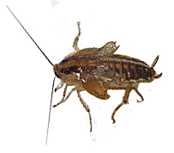
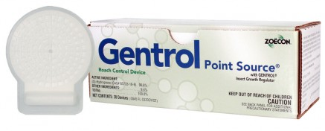
Insect growth regulators (IGRs)
Sprays, aerosols, and impregnated discs
Interfere with cockroach growth and egg hatching
Take a month to work,
Effective for +/- 90 days
Compatible with other IPM methods; may enhance baits
Notes:
Before approving conventional sprays, IPM Coordinators should consider insect growth regulators. Communication between the PMP and the resident will also help the resident understand the service and address pesticide concerns, vulnerabilities, or sensitivities. The goal is to have everyone understand why conventional pesticide sprays are not to be used. Insect growth regulators (IGRs) may be sprayed in cracks and crevices by PMPs using a spray application by a PMP. The PMP may explain, “I am applying a pesticide that makes it so that the cockroaches can’t grow up properly. It’s called an insect growth regulator and it is a pesticide that poses less risk to you and your family than the sprays you may have seen before. Don’t expect to see dead cockroaches right away. IGRs take a few weeks to work.”
IGRs can be a good choice when transitioning to an IPM program. IGRs help prevent reinfestation. They prevent cockroaches from maturing, so they cannot reproduce. IGRs are slow-acting (it will take at least two weeks to see a change), but they are a good option when used with bait and dusts. Most stay active for 90 days.
Using IGRs for German cockroaches may promote cockroaches feeding more heavily on bait until they die. PMPs should not spray them directly over the bait.

Slide 32
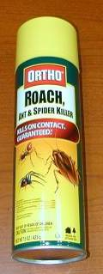

Ineffective and Unsafe
Over-the-counter sprays & foggers are not part of IPM in multifamily housing
They are not compatible with baits
Cockroaches develop resistance
Notes:
32
There are more effective products than over the counter sprays and foggers that pose less risk and get at the source of the pest problem.
Sprays and foggers—whether in a pump-up sprayer or pressurized can—deliver pesticides to kill cockroaches. In general, these pesticides repel the cockroaches or kill them on contact. Some items to note:
Repelling cockroaches may only chase cockroaches to another unit. Furthermore, it is difficult to reach cockroaches with sprays. As a result, the sprays do not usually get the hiding cockroaches and have limited duration. The quick—and sometimes—visible kill does not last.
The sprays may contaminate the baits, rendering them useless. If the bait is contaminated, the cockroach will not go in the bait station to feed.
The spray or fogger may result in pesticide exposure to people. Given the effectiveness of baits, this exposure and the health risks may be unnecessary.
Generally PMPs should not be using sprays to kill cockroaches even though many still rely on it—partly because they think the customer expects to see it. There is no need to broadcast spray for cockroaches if IPM is being used.
If sprays must be used as a spot treatment in specific areas, premixed are less risky to use than concentrates that must be diluted. Errors in measurement or dilution are avoided and the chance of spills and accidental exposure is reduced. Premixes are available in gallon containers that often include trigger sprayers or may be poured into pressure sprayers. These sprays may be applied only by licensed PMPs.

Slide 33
IPM practice
What’s the problem here?
Who is responsible?
How would you fix it?
Notes:
33
Good place to add photos of the site facility when possible
Trainees should now apply what they’ve learned.
Trainees should suggest that cleaning and drying dishes nightly and picking up pet food at night will go a long way to control the pest at no cost to the property.
This example shows how knowledge of the pest along with awareness of the environment and a simple change in practices can result in pest management.
Suggestion: Discuss the use of a pan under pet food and water dishes. This makes it easier to pick up spills from a sloppy eater and may restrict some pests from feeding.

Slide 34
Insert facility slides
Notes:
Delete these slides if you don’t have site photos

Slide 35
Module Review or Workplan
(What will you do now?)
Who does what?
Contract/Policy requirements
Monitoring
Sanitation/cleaning
Exclusion: Sealing cracks & crevices
Vacuuming
Repairing leaks
Pesticide application
NO routine spraying
NO pyrethroid sprays
Monitors in all units
Use (based on monitor counts):
    Baits
    Dusts
    IGRs
Follow-up treatment/schedule every 2-4 weeks
Baits rotated monthly

Slide 36



Questions?
Notes:
36
After questions are answered or written in the parking lot, give trainees a break.
To keep the day running smoothly, tell them how long the break is and exactly what time they should be back to the training space.

